Slide 1

LESSON 6
Finding and Fixing Bugs
Find, explain and fix errors while improving creative Python outcomes.
Teaching presentation
Code Kaleidoscope • Creative Code. Colourful Thinking.
1

Slide 2
LESSON 6
Learning Aim
Find, explain and fix errors while improving creative Python outcomes.
Key vocabulary
debugging • syntax • testing • improvement
Code Kaleidoscope • Creative Code. Colourful Thinking.
2

Slide 3
DO NOW
Find the Bug
for i in range(4)
forward(100)
right(90)
Questions
• Can you spot the mistake?
• What error might appear?
• How would you fix it?
• Why is testing important?
Stretch: What shape should the corrected code draw?
Code Kaleidoscope • Creative Code. Colourful Thinking.
3

Slide 4
RETRIEVAL
Quick Check
1. What is an integer?
2. What is a string?
3. How can random values change output?
Code Kaleidoscope • Creative Code. Colourful Thinking.
4

Slide 5
THEORY
Big Idea
Debugging means finding and fixing errors.
Good programmers test small changes and use error messages as clues.
Teacher prompt: pause, predict, test, then explain.
Code Kaleidoscope • Creative Code. Colourful Thinking.
5

Slide 6
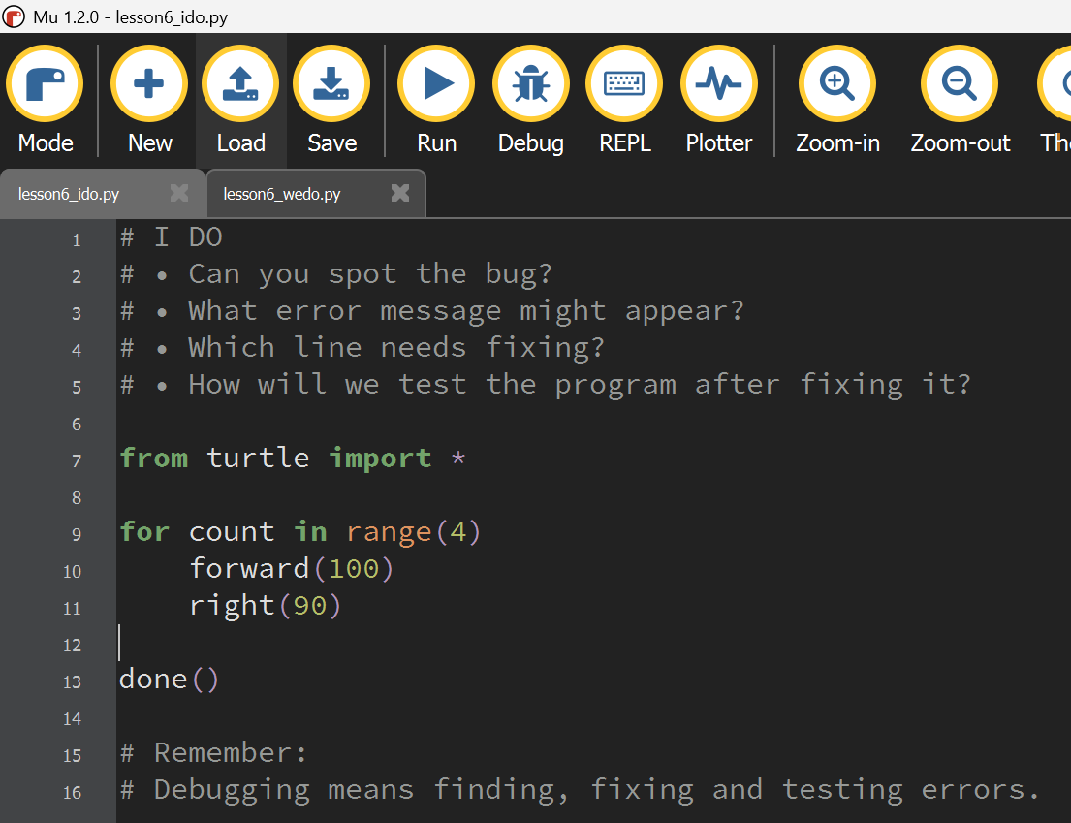
I DO
Study the Mu Editor example below. Predict what the code will do before running it.
Download I Do .py file
I_do_we_do/lesson6_ido.py
Code Kaleidoscope • Creative Code. Colourful Thinking.
6

Slide 7
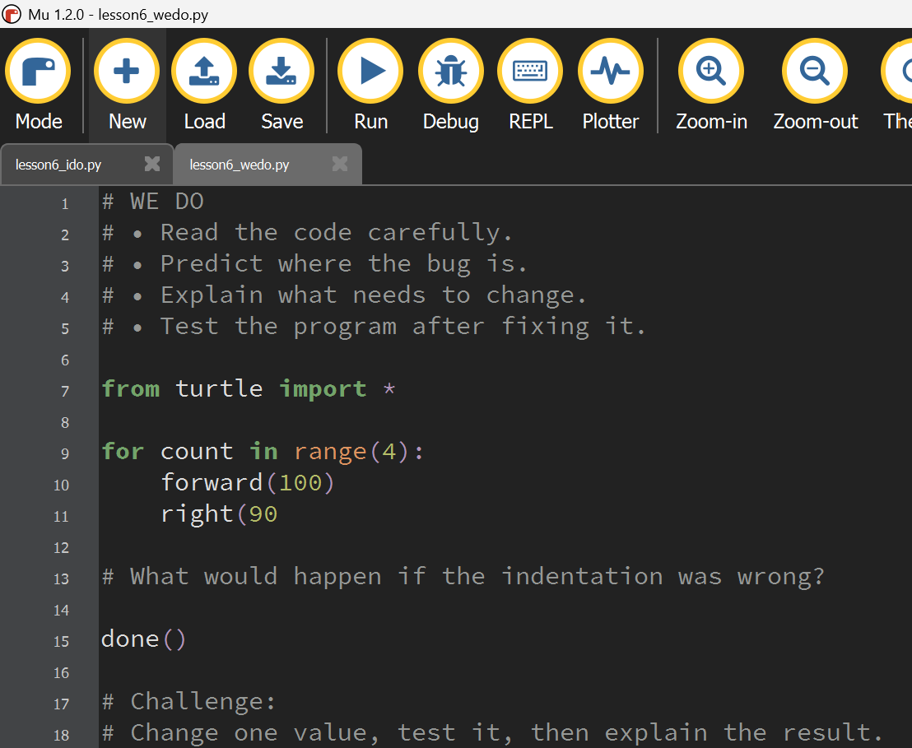
WE DO
Study the Mu Editor example below. Predict what the code will do before running it.
Download We Do .py file
I_do_we_do/lesson6_wedo.py
Code Kaleidoscope • Creative Code. Colourful Thinking.
7

Slide 8
YOU DO
Independent Task
Improve a creative program by finding and fixing errors.
Teacher prompt: pause, predict, test, then explain.
Code Kaleidoscope • Creative Code. Colourful Thinking.
8

Slide 9
WORKBOOK
Record Your Thinking
Record one bug, the fix, and how the output improved.
Teacher prompt: pause, predict, test, then explain.
Code Kaleidoscope • Creative Code. Colourful Thinking.
9

Slide 10
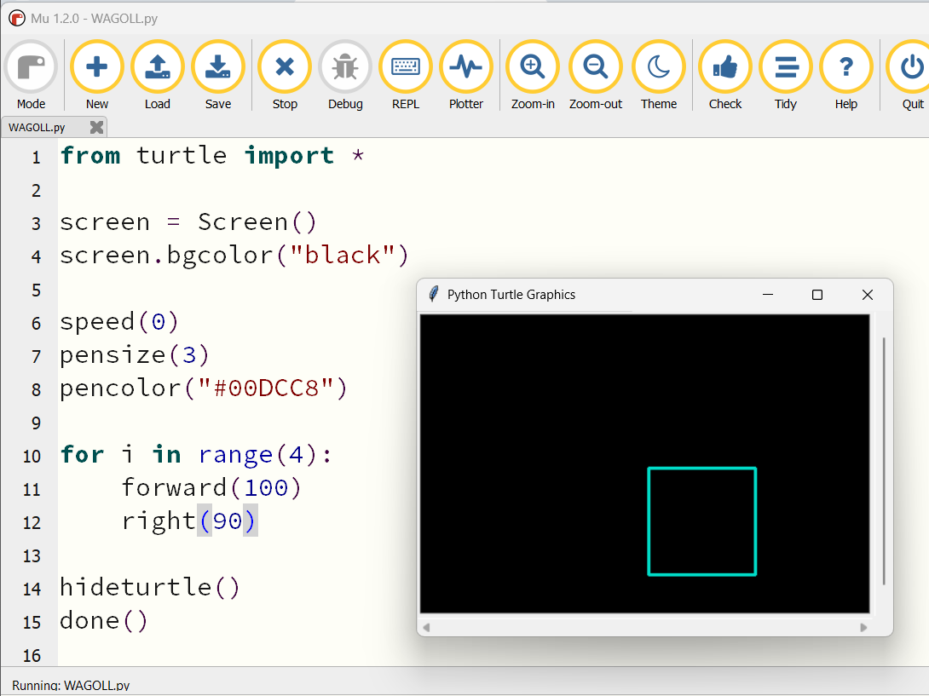
WAGOLL
What a Good One Looks Like
Use this example to discuss what works well and what could be modified.
Code Kaleidoscope • Creative Code. Colourful Thinking.
10

Slide 11
SUCCESS CRITERIA
By the End of the Lesson
✓ I can spot a syntax error.
✓ I can test code after changes.
✓ I can explain how I fixed a bug.
Code Kaleidoscope • Creative Code. Colourful Thinking.
11

Slide 12
PLENARY
Plenary Question
What debugging strategy helped you most today?
Answer in your workbook using key vocabulary from today.
Code Kaleidoscope • Creative Code. Colourful Thinking.
12

