Slide 1

LESSON 5
Generative Art with Data
Use data types and random values to create controlled variation.
Teaching presentation
Code Kaleidoscope • Creative Code. Colourful Thinking.
1

Slide 2
LESSON 5
Learning Aim
Use data types and random values to create controlled variation.
Key vocabulary
integer • string • random • data type
Code Kaleidoscope • Creative Code. Colourful Thinking.
2

Slide 3
DO NOW
Sort the Data
12 "blue" 50 "teal"
100 "flower" 36 "circle"
Questions
• Which values are numbers?
• Which values are text?
• Which values could control a Turtle design?
Stretch: What might randint(1, 10) do?
Code Kaleidoscope • Creative Code. Colourful Thinking.
3

Slide 4
RETRIEVAL
Quick Check
1. What is a loop?
2. What does iteration mean?
3. How can repeated turns create symmetry?
Code Kaleidoscope • Creative Code. Colourful Thinking.
4

Slide 5
THEORY
Big Idea
Different data types behave differently.
Random values can add variation while variables keep the program controllable.
Teacher prompt: pause, predict, test, then explain.
Code Kaleidoscope • Creative Code. Colourful Thinking.
5

Slide 6
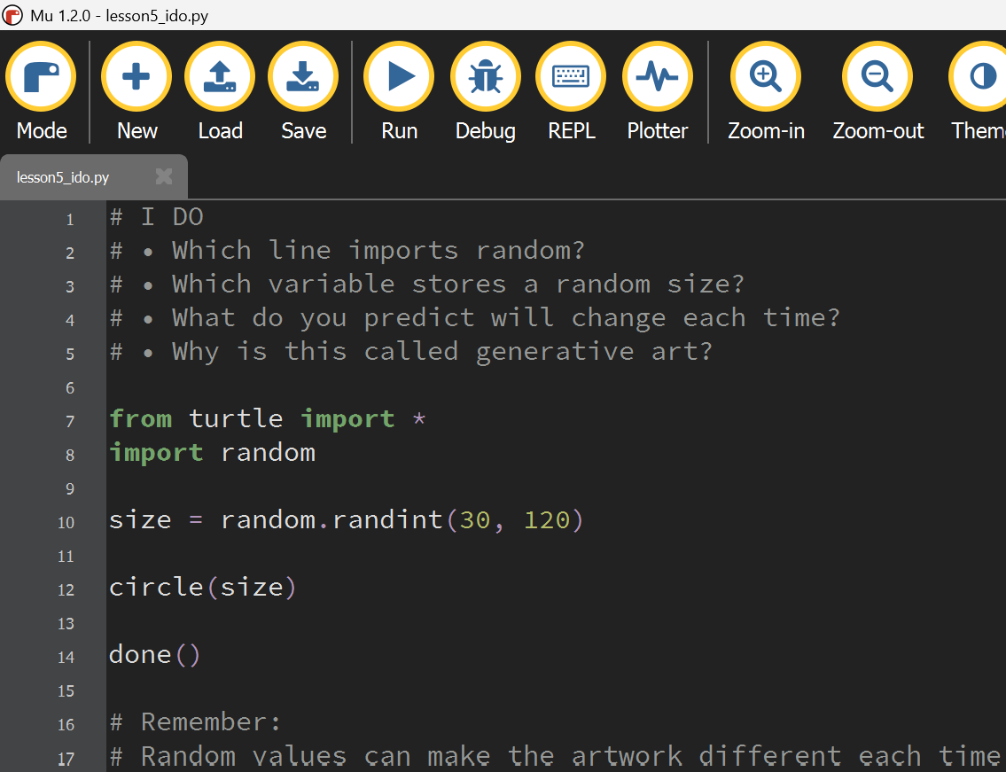
I DO
Study the Mu Editor example below. Predict what the code will do before running it.
Download I Do .py file
I_do_we_do/lesson5_ido.py
Code Kaleidoscope • Creative Code. Colourful Thinking.
6

Slide 7
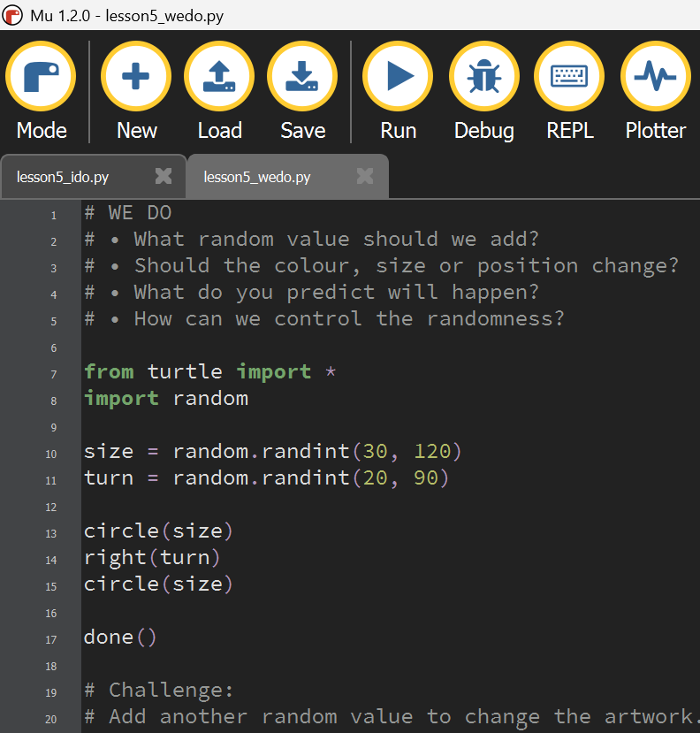
WE DO
Study the Mu Editor example below. Predict what the code will do before running it.
Download We Do .py file
I_do_we_do/lesson5_wedo.py
Code Kaleidoscope • Creative Code. Colourful Thinking.
7

Slide 8
YOU DO
Independent Task
Create a controlled generative artwork using data and random values.
Teacher prompt: pause, predict, test, then explain.
Code Kaleidoscope • Creative Code. Colourful Thinking.
8

Slide 9
WORKBOOK
Record Your Thinking
Sort data types and explain one random outcome.
Teacher prompt: pause, predict, test, then explain.
Code Kaleidoscope • Creative Code. Colourful Thinking.
9

Slide 10
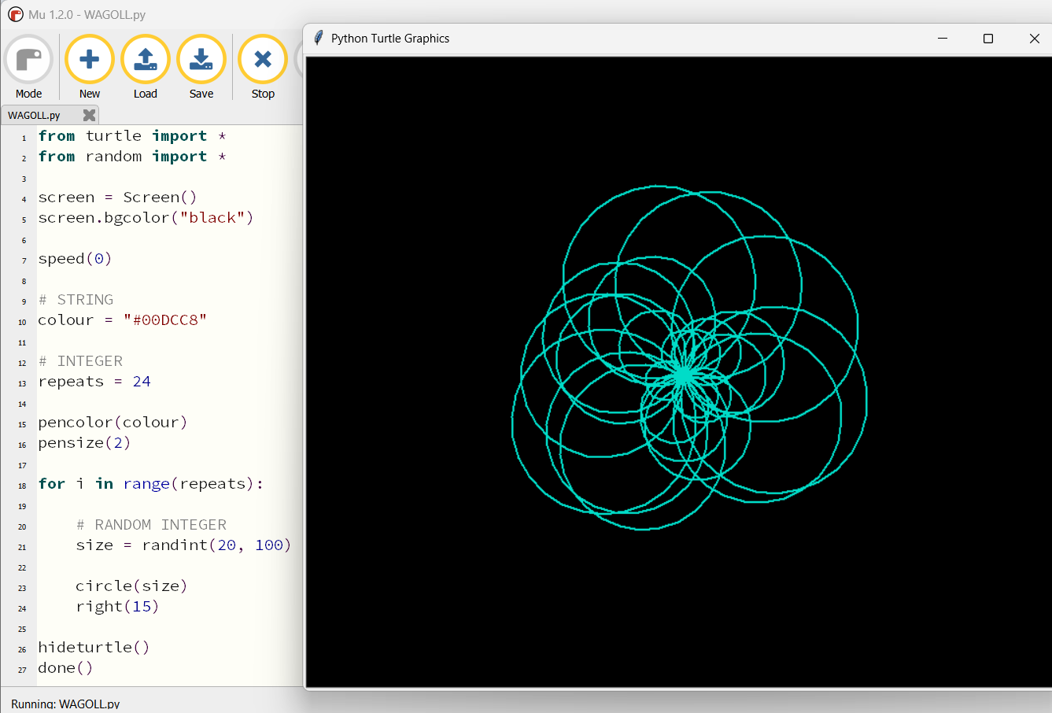
WAGOLL
What a Good One Looks Like
Use this example to discuss what works well and what could be modified.
Code Kaleidoscope • Creative Code. Colourful Thinking.
10

Slide 11
SUCCESS CRITERIA
By the End of the Lesson
✓ I can identify integers and strings.
✓ I can use random values.
✓ I can explain controlled variation.
Code Kaleidoscope • Creative Code. Colourful Thinking.
11

Slide 12
PLENARY
Plenary Question
How did random values change your artwork?
Answer in your workbook using key vocabulary from today.
Code Kaleidoscope • Creative Code. Colourful Thinking.
12

