Slide 1

LESSON 4
Loops and Kaleidoscope Patterns
Use loops to repeat shapes and create symmetrical patterns.
Teaching presentation
Code Kaleidoscope • Creative Code. Colourful Thinking.
1

Slide 2
LESSON 4
Learning Aim
Use loops to repeat shapes and create symmetrical patterns.
Key vocabulary
loop • iteration • repeat • symmetry
Code Kaleidoscope • Creative Code. Colourful Thinking.
2

Slide 3
DO NOW
Repetition Challenge
forward(100)
right(90)
forward(100)
right(90)
forward(100)
right(90)
forward(100)
right(90)
Questions
• What shape will this draw?
• What is repeated?
• How many times is it repeated?
• How could a loop make this shorter?
Stretch: Write the number of repeats needed.
Code Kaleidoscope • Creative Code. Colourful Thinking.
3

Slide 4
RETRIEVAL
Quick Check
1. What does if mean?
2. What is a condition?
3. What happens when a condition is false?
Code Kaleidoscope • Creative Code. Colourful Thinking.
4

Slide 5
THEORY
Big Idea
Loops repeat code.
This reduces repetition and helps create patterns, symmetry and generative designs.
Teacher prompt: pause, predict, test, then explain.
Code Kaleidoscope • Creative Code. Colourful Thinking.
5

Slide 6
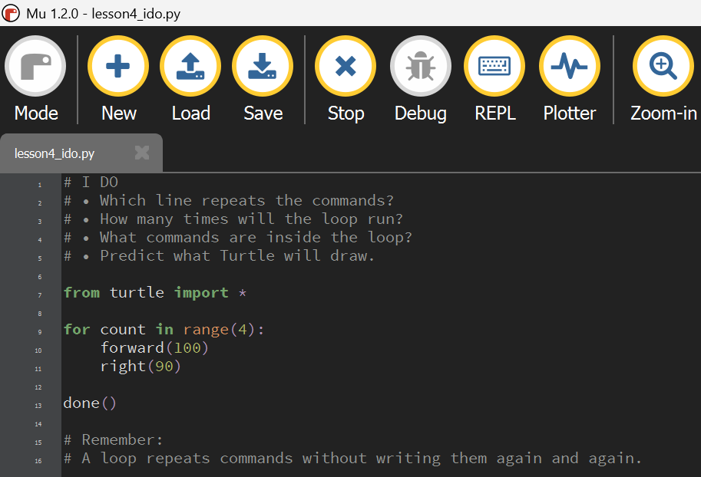
I DO
Study the Mu Editor example below. Predict what the code will do before running it.
Download I Do .py file
I_do_we_do/lesson4_ido.py
Code Kaleidoscope • Creative Code. Colourful Thinking.
6

Slide 7
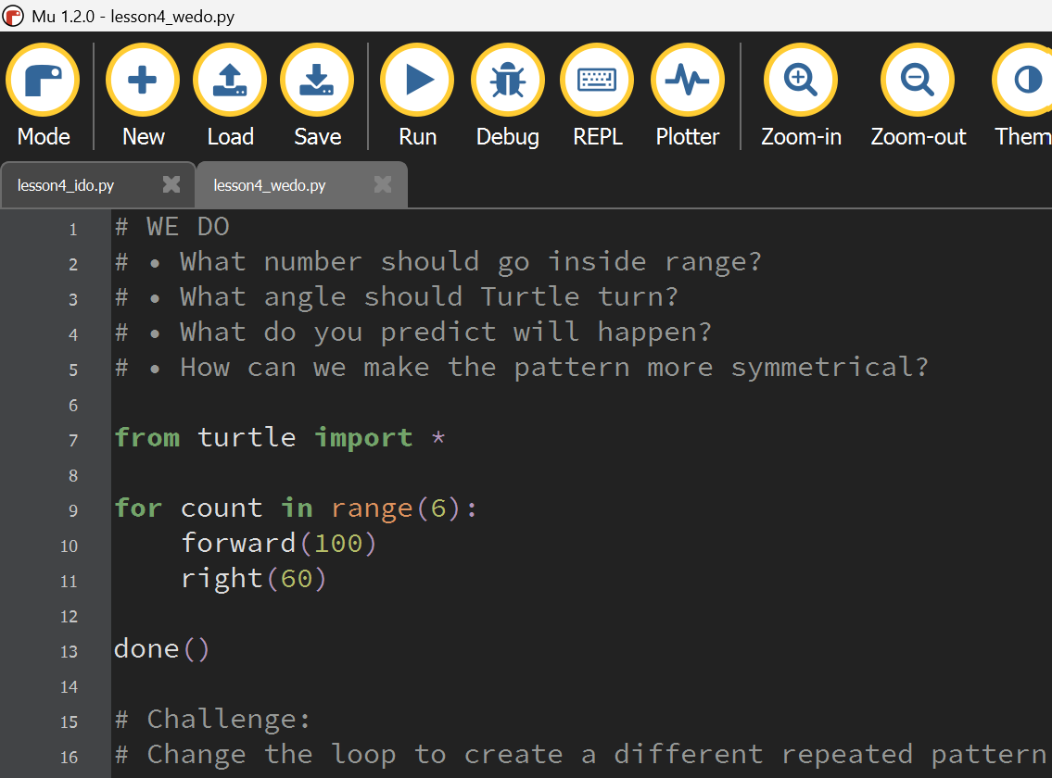
WE DO
Study the Mu Editor example below. Predict what the code will do before running it.
Download We Do .py file
I_do_we_do/lesson4_wedo.py
Code Kaleidoscope • Creative Code. Colourful Thinking.
7

Slide 8
YOU DO
Independent Task
Create a kaleidoscope pattern using repeated Turtle movement.
Teacher prompt: pause, predict, test, then explain.
Code Kaleidoscope • Creative Code. Colourful Thinking.
8

Slide 9
WORKBOOK
Record Your Thinking
Record how the loop changes the output.
Teacher prompt: pause, predict, test, then explain.
Code Kaleidoscope • Creative Code. Colourful Thinking.
9

Slide 10
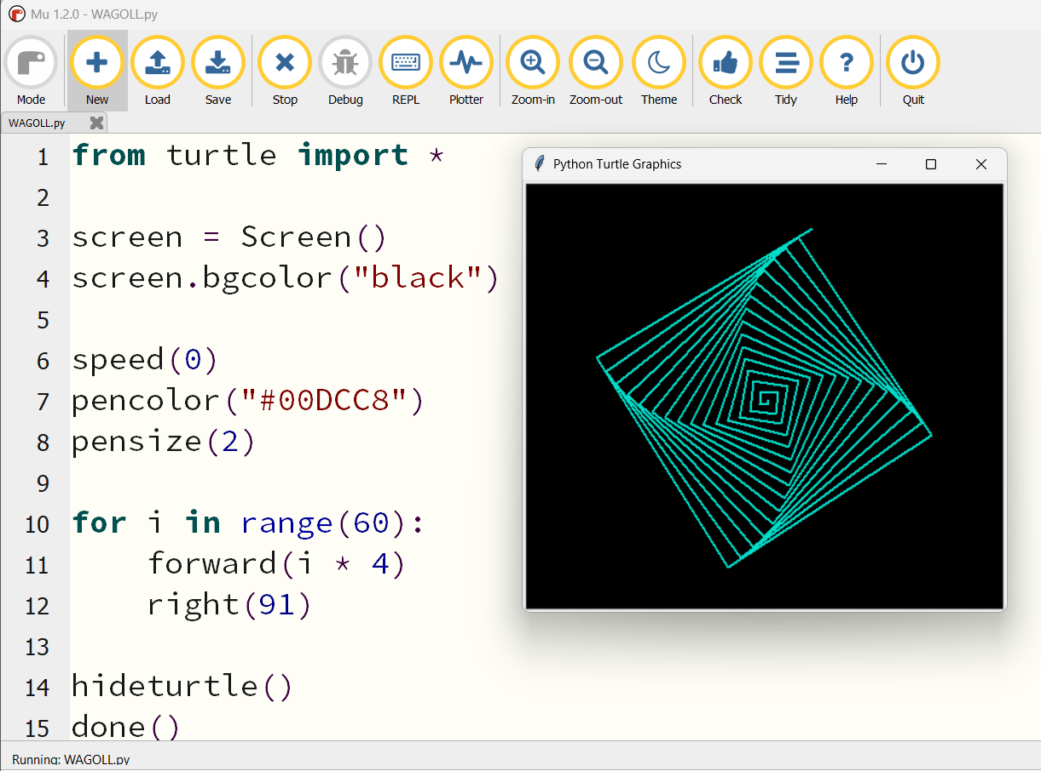
WAGOLL
What a Good One Looks Like
Use this example to discuss what works well and what could be modified.
Code Kaleidoscope • Creative Code. Colourful Thinking.
10

Slide 11
SUCCESS CRITERIA
By the End of the Lesson
✓ I can identify repeated code.
✓ I can use a for loop.
✓ I can explain how iteration creates symmetry.
Code Kaleidoscope • Creative Code. Colourful Thinking.
11

Slide 12
PLENARY
Plenary Question
How did the loop make your code more efficient?
Answer in your workbook using key vocabulary from today.
Code Kaleidoscope • Creative Code. Colourful Thinking.
12

