Slide 1

LESSON 3
Drawing with Decisions
Use selection to make a drawing respond to different choices.
Teaching presentation
Code Kaleidoscope • Creative Code. Colourful Thinking.
1

Slide 2
LESSON 3
Learning Aim
Use selection to make a drawing respond to different choices.
Key vocabulary
selection • condition • if • else
Code Kaleidoscope • Creative Code. Colourful Thinking.
2

Slide 3
DO NOW
What Happens Next?
if colour == "blue":
circle(50)
else:
square(50)
Questions
• What shape will be drawn if colour is blue?
• What shape will be drawn if colour is red?
• What does if mean?
• Why is selection useful?
Stretch: Think of a real-life example of selection.
Code Kaleidoscope • Creative Code. Colourful Thinking.
3

Slide 4
RETRIEVAL
Quick Check
1. What is a variable?
2. Which data type stores text?
3. How can input change output?
Code Kaleidoscope • Creative Code. Colourful Thinking.
4

Slide 5
THEORY
Big Idea
Selection lets a program choose between different actions using if, elif and else.
Teacher prompt: pause, predict, test, then explain.
Code Kaleidoscope • Creative Code. Colourful Thinking.
5

Slide 6
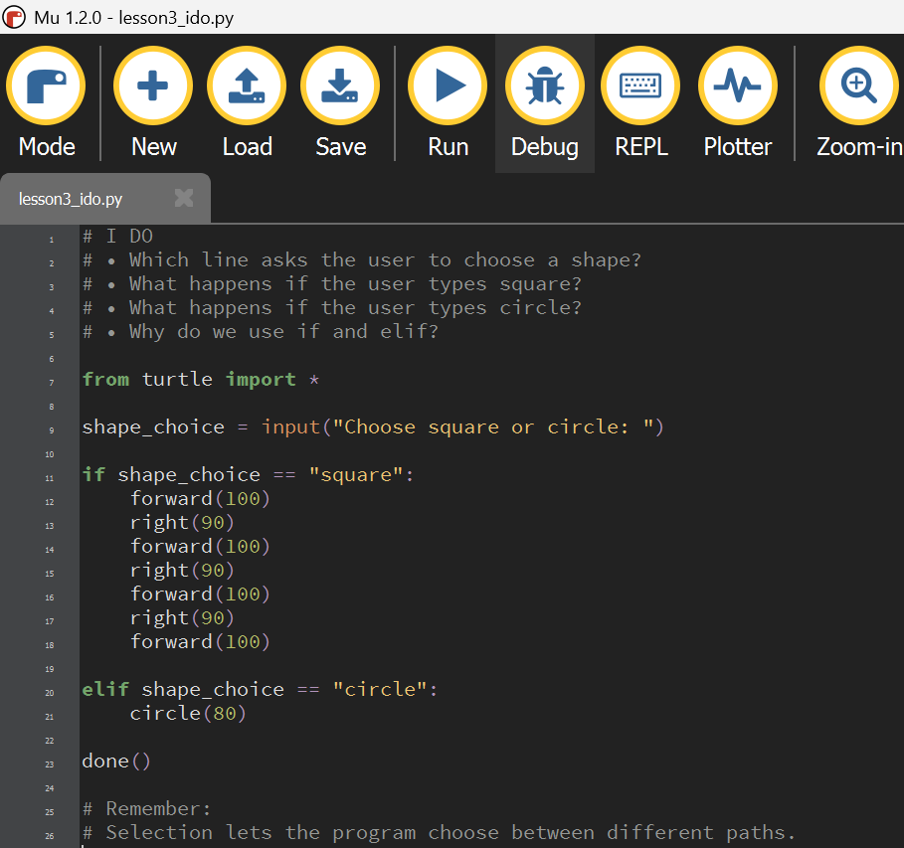
I DO
Study the Mu Editor example below. Predict what the code will do before running it.
Download I Do .py file
I_do_we_do/lesson3_ido.py
Code Kaleidoscope • Creative Code. Colourful Thinking.
6

Slide 7
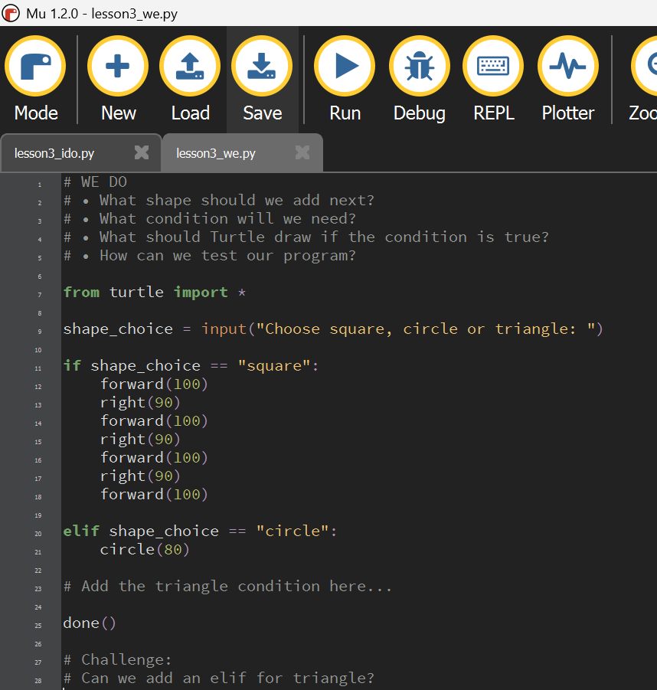
WE DO
Study the Mu Editor example below. Predict what the code will do before running it.
Download We Do .py file
I_do_we_do/lesson3_we.py
Code Kaleidoscope • Creative Code. Colourful Thinking.
7

Slide 8
YOU DO
Independent Task
Create a drawing that changes based on a choice.
Teacher prompt: pause, predict, test, then explain.
Code Kaleidoscope • Creative Code. Colourful Thinking.
8

Slide 9
WORKBOOK
Record Your Thinking
Investigate the condition and explain the output.
Teacher prompt: pause, predict, test, then explain.
Code Kaleidoscope • Creative Code. Colourful Thinking.
9

Slide 10
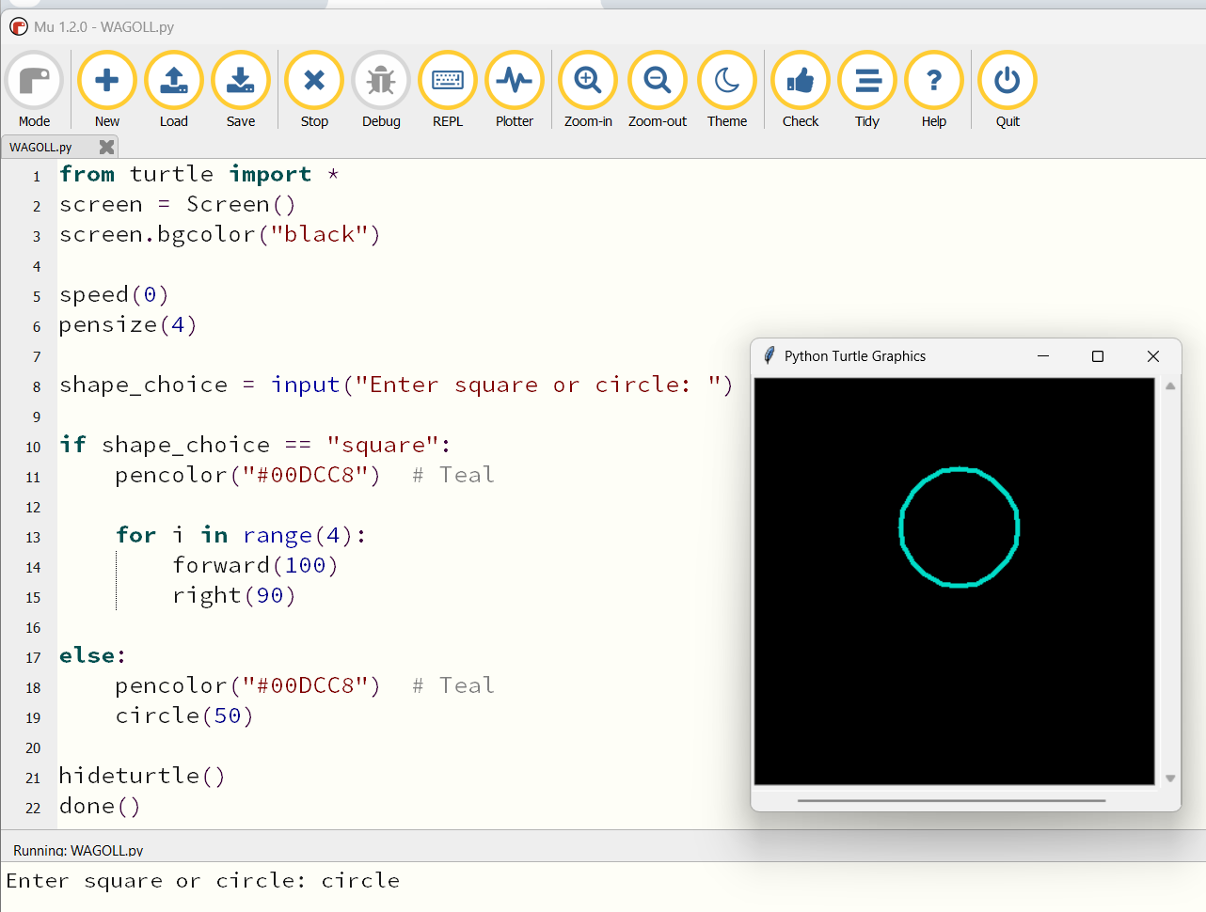
WAGOLL
What a Good One Looks Like
Use this example to discuss what works well and what could be modified.
Code Kaleidoscope • Creative Code. Colourful Thinking.
10

Slide 11
SUCCESS CRITERIA
By the End of the Lesson
✓ I can read an if statement.
✓ I can test different outcomes.
✓ I can explain selection in a creative program.
Code Kaleidoscope • Creative Code. Colourful Thinking.
11

Slide 12
PLENARY
Plenary Question
Why is selection useful in interactive artwork?
Answer in your workbook using key vocabulary from today.
Code Kaleidoscope • Creative Code. Colourful Thinking.
12

