Slide 1

LESSON 2
Variables and Interactive Art
Use variables to control size, colour and repeated values in a creative drawing.
Teaching presentation
Code Kaleidoscope • Creative Code. Colourful Thinking.
1

Slide 2
LESSON 2
Learning Aim
Use variables to control size, colour and repeated values in a creative drawing.
Key vocabulary
variable • value • input • output
Code Kaleidoscope • Creative Code. Colourful Thinking.
2

Slide 3
DO NOW
Guess the Variable
size = 50
colour = "blue"
repeats = 12
Questions
• Which variable controls the size?
• Which variable stores text?
• Which variable might control symmetry?
• What might happen if repeats becomes 24?
Stretch: Write your own variable.
Code Kaleidoscope • Creative Code. Colourful Thinking.
3

Slide 4
RETRIEVAL
Quick Check
1. What is sequence?
2. What is syntax?
3. What does Turtle do when commands are in the wrong order?
Code Kaleidoscope • Creative Code. Colourful Thinking.
4

Slide 5
THEORY
Big Idea
A variable stores a value.
Changing the value changes the output without rewriting every command.
Teacher prompt: pause, predict, test, then explain.
Code Kaleidoscope • Creative Code. Colourful Thinking.
5

Slide 6
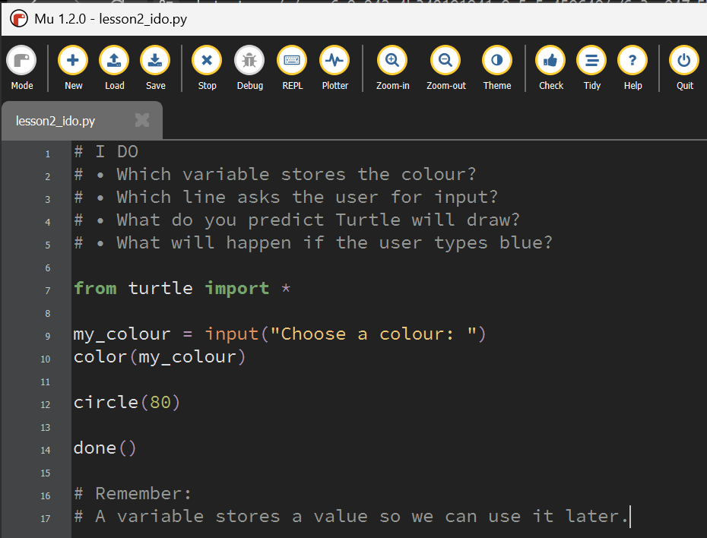
I DO
Study the Mu Editor example below. Predict what the code will do before running it.
Download I Do .py file
I_do_we_do/lesson2_ido.py
Code Kaleidoscope • Creative Code. Colourful Thinking.
6

Slide 7
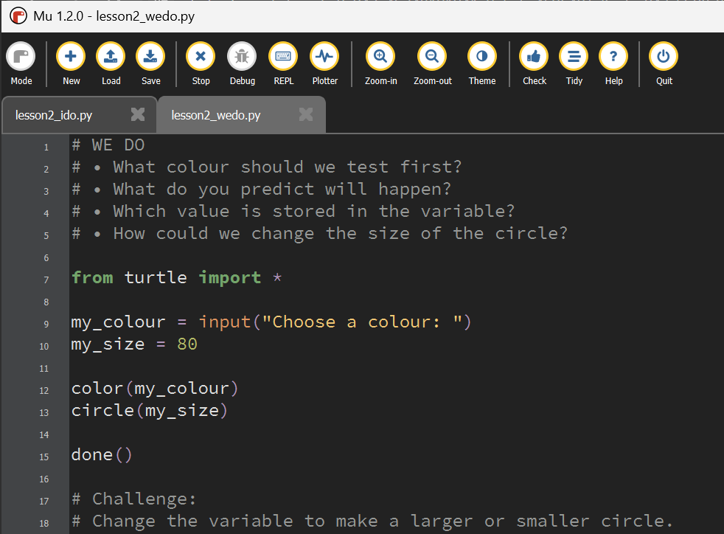
WE DO
Study the Mu Editor example below. Predict what the code will do before running it.
Download We Do .py file
I_do_we_do/lesson2_wedo.py
Code Kaleidoscope • Creative Code. Colourful Thinking.
7

Slide 8
YOU DO
Independent Task
Create an artwork by changing size, colour and repeat values.
Teacher prompt: pause, predict, test, then explain.
Code Kaleidoscope • Creative Code. Colourful Thinking.
8

Slide 9
WORKBOOK
Record Your Thinking
Complete the variable investigation and record what changed.
Teacher prompt: pause, predict, test, then explain.
Code Kaleidoscope • Creative Code. Colourful Thinking.
9

Slide 10
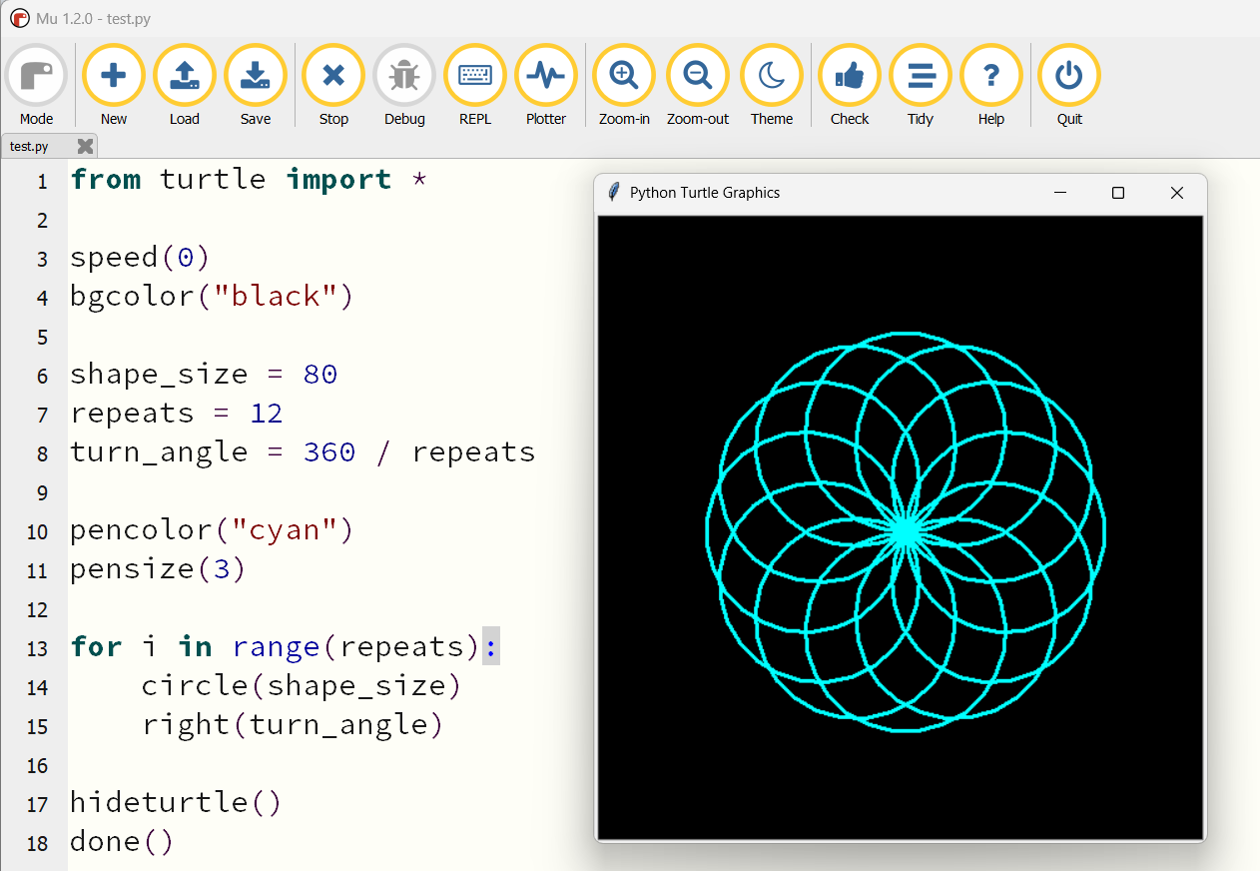
WAGOLL
What a Good One Looks Like
Use this example to discuss what works well and what could be modified.
Code Kaleidoscope • Creative Code. Colourful Thinking.
10

Slide 11
SUCCESS CRITERIA
By the End of the Lesson
✓ I can identify a variable.
✓ I can change a value.
✓ I can explain how a variable affects output.
Code Kaleidoscope • Creative Code. Colourful Thinking.
11

Slide 12
PLENARY
Plenary Question
Which variable had the biggest effect on your design?
Answer in your workbook using key vocabulary from today.
Code Kaleidoscope • Creative Code. Colourful Thinking.
12

