Slide 1
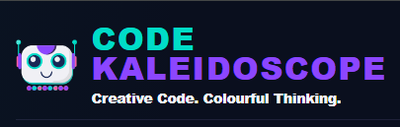
LESSON 1
From Scratch to Turtle Python
Use Mu Editor to write Python Turtle commands and compare them with Scratch movement blocks.
Teaching presentation
Code Kaleidoscope • Creative Code. Colourful Thinking.
1

Slide 2
LESSON 1
Learning Aim
Use Mu Editor to write Python Turtle commands and compare them with Scratch movement blocks.
Key vocabulary
sequence • command • syntax • turtle
Code Kaleidoscope • Creative Code. Colourful Thinking.
2

Slide 3
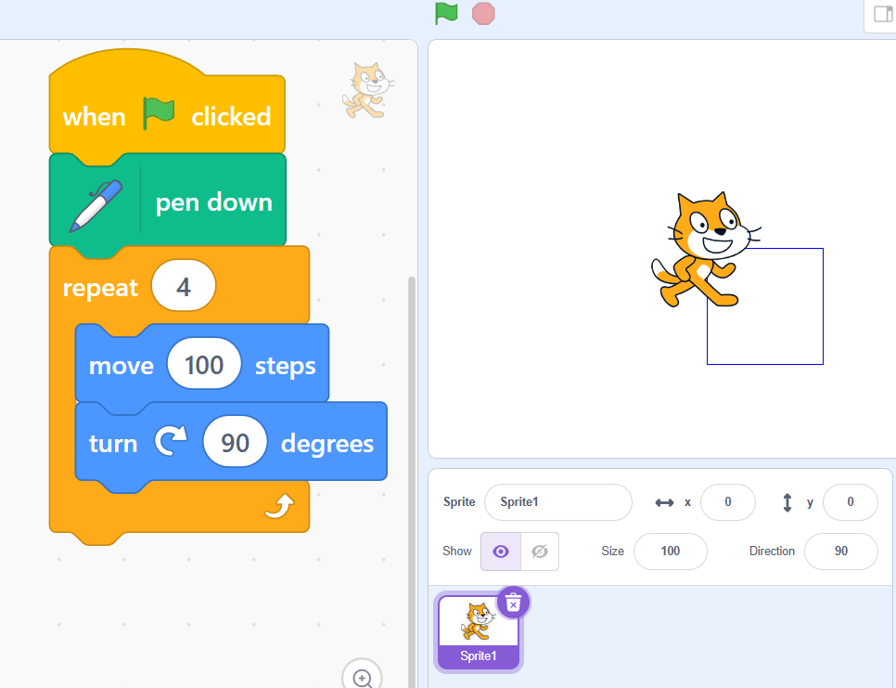
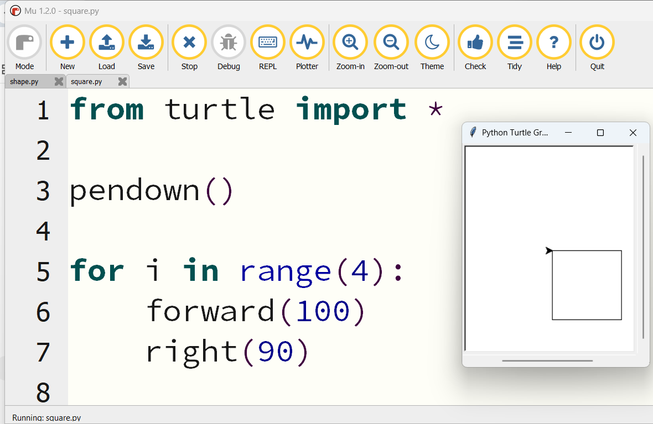
DO NOW
Scratch vs Python
Look closely. What can you predict before we code?
• What is similar?
• What is different?
• Which version do you think is easier to read?
• What do you think the Python code will do?
Stretch: Circle or list any words you recognise from Scratch.
Code Kaleidoscope • Creative Code. Colourful Thinking.
3

Slide 4
RETRIEVAL
Quick Check
1. What is an algorithm?
2. What does the move block do in Scratch?
3. What is sequence?
Code Kaleidoscope • Creative Code. Colourful Thinking.
4

Slide 5
THEORY
Big Idea
Python runs commands in order.
Turtle follows each instruction exactly, just like a sprite following Scratch blocks.
Teacher prompt: pause, predict, test, then explain.
Code Kaleidoscope • Creative Code. Colourful Thinking.
5

Slide 6
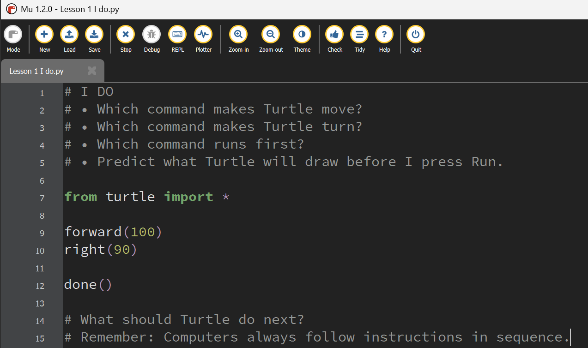
I DO
Study the Mu Editor example below. Predict what the code will do before running it.
Download I Do .py file
I_do_we_do/Lesson 1 I do.py
Code Kaleidoscope • Creative Code. Colourful Thinking.
6

Slide 7
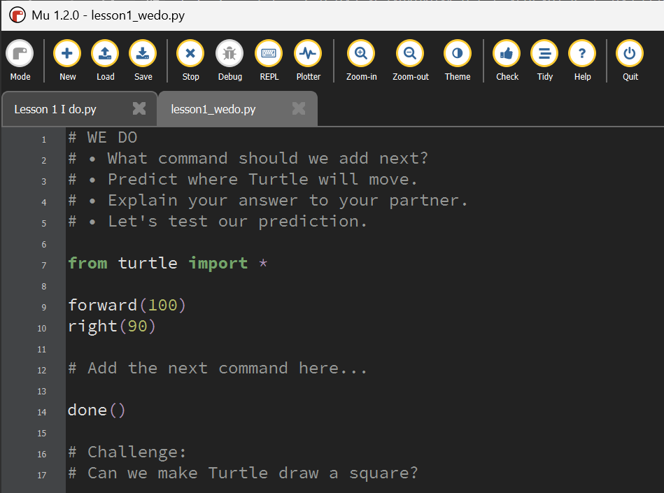
WE DO
Study the Mu Editor example below. Predict what the code will do before running it.
Download We Do .py file
I_do_we_do/lesson1_wedo.py
Code Kaleidoscope • Creative Code. Colourful Thinking.
7

Slide 8
YOU DO
Independent Task
Bronze: triangle.
Silver: square with a different size.
Gold: initials using movement.
Teacher prompt: pause, predict, test, then explain.
Code Kaleidoscope • Creative Code. Colourful Thinking.
8

Slide 9
WORKBOOK
Record Your Thinking
Record your prediction, code observations and plenary answer.
Teacher prompt: pause, predict, test, then explain.
Code Kaleidoscope • Creative Code. Colourful Thinking.
9

Slide 10
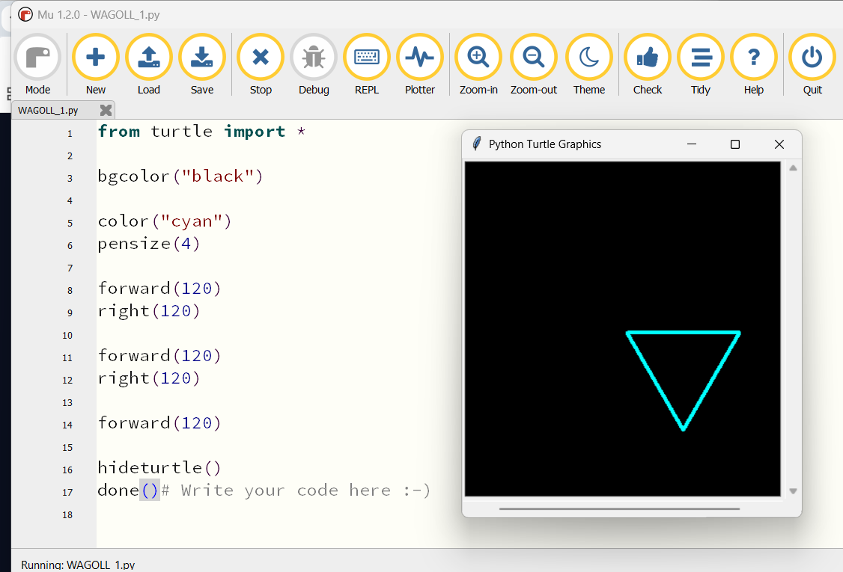
WAGOLL
What a Good One Looks Like
Use this example to discuss what works well and what could be modified.
Code Kaleidoscope • Creative Code. Colourful Thinking.
10

Slide 11
SUCCESS CRITERIA
By the End of the Lesson
✓ I can type Turtle commands.
✓ I can explain why sequence matters.
✓ I can modify movement values.
Code Kaleidoscope • Creative Code. Colourful Thinking.
11

Slide 12
PLENARY
Plenary Question
How is Turtle similar to Scratch?
Answer in your workbook using key vocabulary from today.
Code Kaleidoscope • Creative Code. Colourful Thinking.
12

