Slide 1

INTRODUCTION LESSON
Exploring Code Kaleidoscope
Explore the drawing workspace, make predictions and explain how code can create visual output.
Teaching presentation
Code Kaleidoscope • Creative Code. Colourful Thinking.
1

Slide 2
INTRODUCTION LESSON
Learning Aim
Explore the drawing workspace, make predictions and explain how code can create visual output.
Key vocabulary
prediction • output • creative coding • symmetry
Code Kaleidoscope • Creative Code. Colourful Thinking.
2

Slide 3

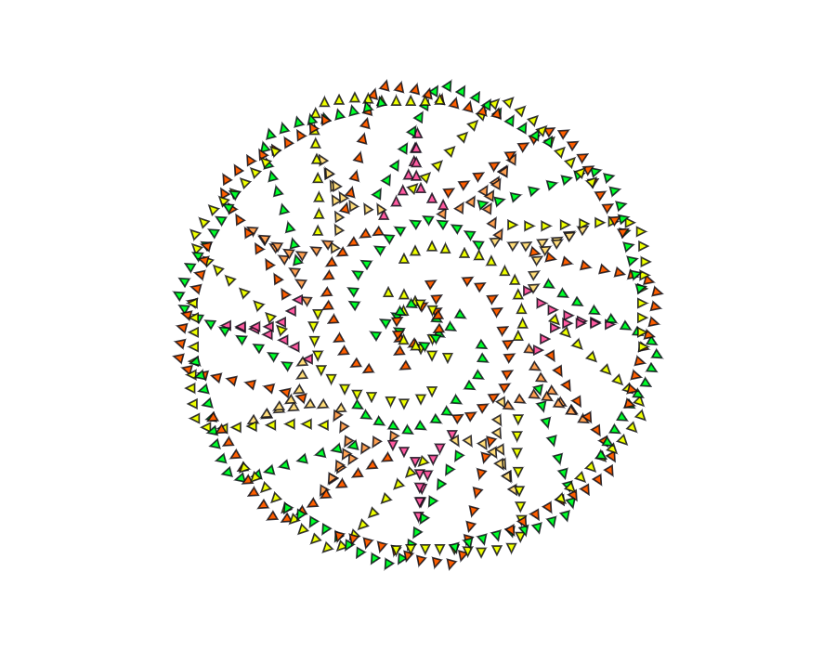

DO NOW
Spot the Pattern
Look closely. What can you predict before we code?
• What patterns can you see?
• What do all the designs have in common?
• How do you think a computer could create these patterns?
• What does the word symmetry mean?
Stretch: What instructions might a computer need to create one of these designs?
Code Kaleidoscope • Creative Code. Colourful Thinking.
3

Slide 4
RETRIEVAL
Quick Check
1. What does input mean?
2. What does output mean?
3. How can changing one value affect a design?
Code Kaleidoscope • Creative Code. Colourful Thinking.
4

Slide 5
THEORY
Big Idea
Code can create artwork by following instructions.
When values change, the visual output changes too.
Teacher prompt: pause, predict, test, then explain.
Code Kaleidoscope • Creative Code. Colourful Thinking.
5

Slide 6

I DO
Study the Code Kaleidoscope example below. Predict what will change before watching.
I Do: watch the teacher model the first Code Kaleidoscope changes.
Code Kaleidoscope • Creative Code. Colourful Thinking.
6

Slide 7
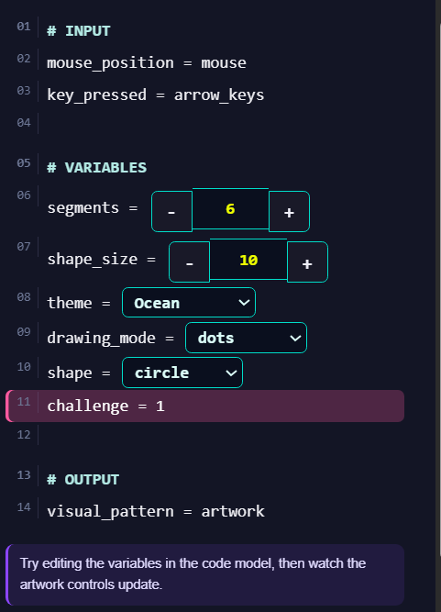
WE DO
Study the Code Kaleidoscope example below. Predict what will change before completing the activity together.
code-kaleidoscope.com
We Do: complete the shared Code Kaleidoscope activity together.
Code Kaleidoscope • Creative Code. Colourful Thinking.
7

Slide 8
YOU DO
Independent Task
Create a simple pattern, then explain which setting changed the output.
Teacher prompt: pause, predict, test, then explain.
Code Kaleidoscope • Creative Code. Colourful Thinking.
8

Slide 9
WORKBOOK
Record Your Thinking
Complete the Do Now and PRIMM notes for the introduction lesson.
Teacher prompt: pause, predict, test, then explain.
Code Kaleidoscope • Creative Code. Colourful Thinking.
9

Slide 10
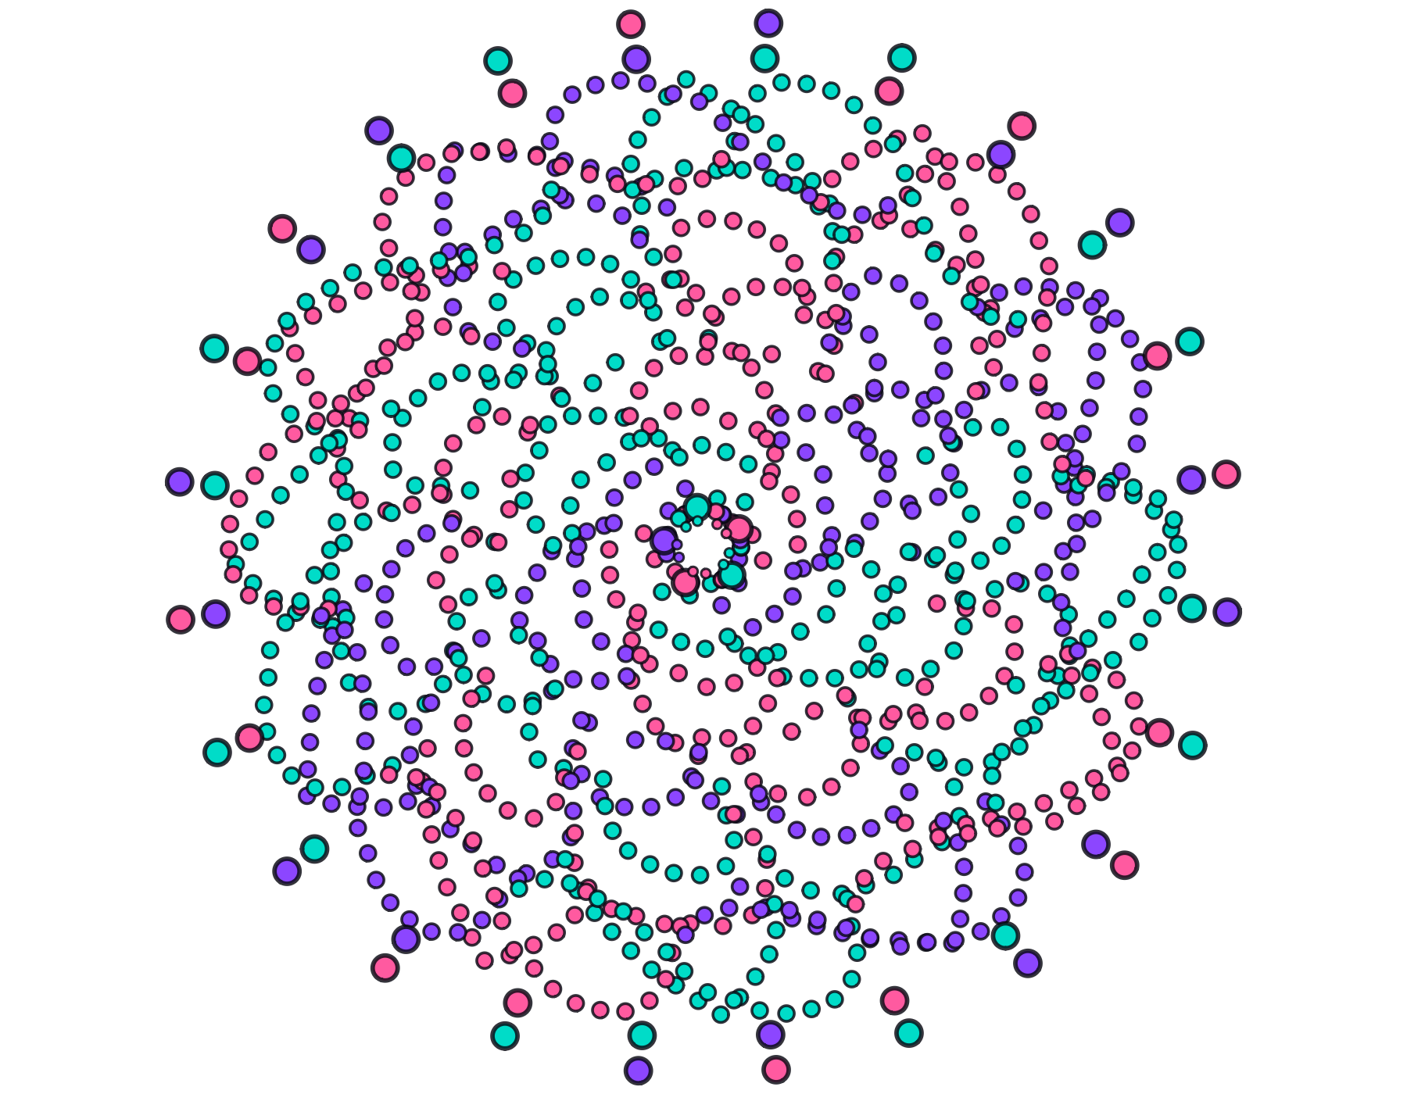
WAGOLL
What a Good One Looks Like
Use this example to discuss what works well and what could be modified.
Code Kaleidoscope • Creative Code. Colourful Thinking.
10

Slide 11
SUCCESS CRITERIA
By the End of the Lesson
✓ I can use the workspace safely.
✓ I can predict what a change might do.
✓ I can describe the output using key vocabulary.
Code Kaleidoscope • Creative Code. Colourful Thinking.
11

Slide 12
PLENARY
Plenary Question
Which setting had the biggest impact on your artwork, and why?
Answer in your workbook using key vocabulary from today.
Code Kaleidoscope • Creative Code. Colourful Thinking.
12

