Slide 1

FINAL PROJECT
Creative Coding Showcase
Plan, build, test and evaluate an original creative coding project.
Teaching presentation
Code Kaleidoscope • Creative Code. Colourful Thinking.
1

Slide 2
FINAL PROJECT
Learning Aim
Plan, build, test and evaluate an original creative coding project.
Key vocabulary
planning • testing • evaluation • independence
Code Kaleidoscope • Creative Code. Colourful Thinking.
2

Slide 3
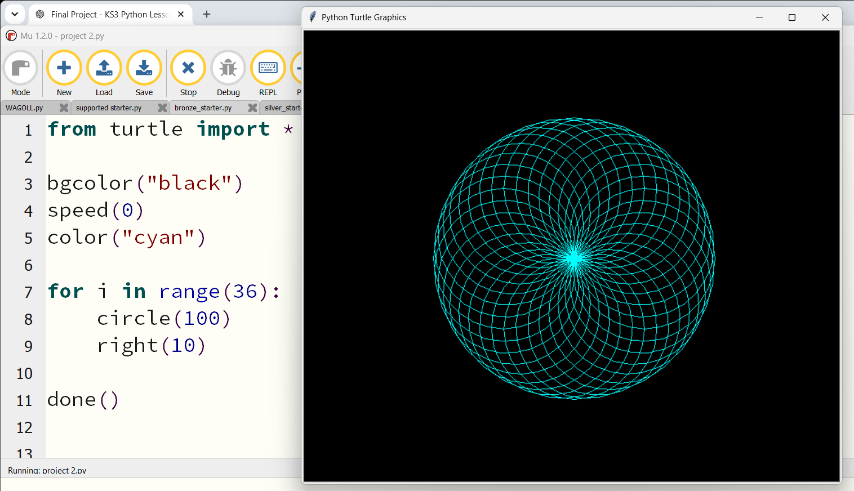
DO NOW
Design Critique
Look closely
• Which programming concepts can you identify?
• What do you like about the design?
• What would you change?
• Which pathway will you choose: Bronze, Silver or Gold? Why?
Stretch: Sketch one improvement you could make.
Code Kaleidoscope • Creative Code. Colourful Thinking.
3

Slide 4
RETRIEVAL
Quick Check
1. Which concept controls choices?
2. Which concept repeats commands?
3. Which data types have we used?
Code Kaleidoscope • Creative Code. Colourful Thinking.
4

Slide 5
THEORY
Big Idea
A strong final project combines planning, code structure, testing and creative design decisions.
Teacher prompt: pause, predict, test, then explain.
Code Kaleidoscope • Creative Code. Colourful Thinking.
5

Slide 6
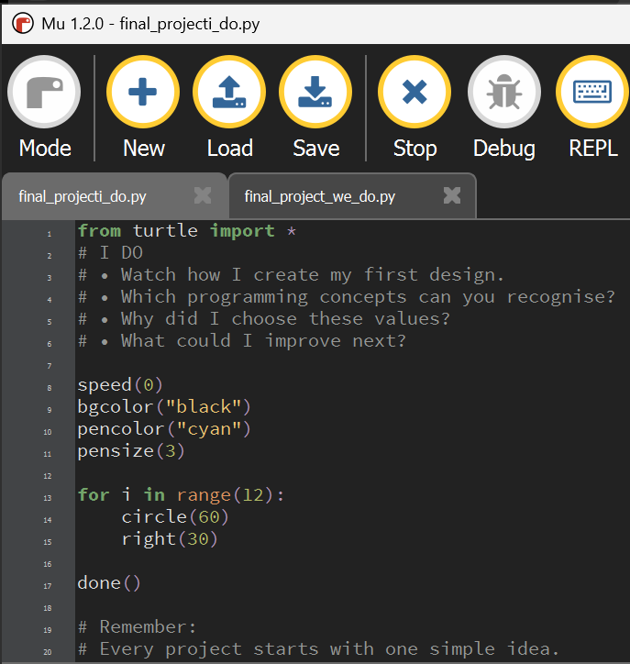
I DO
Study the final project example below. Predict what students will need to change before starting.
I Do: model reading the starter file and identifying editable parts.
Download I Do .py file
Code Kaleidoscope • Creative Code. Colourful Thinking.
6

Slide 7
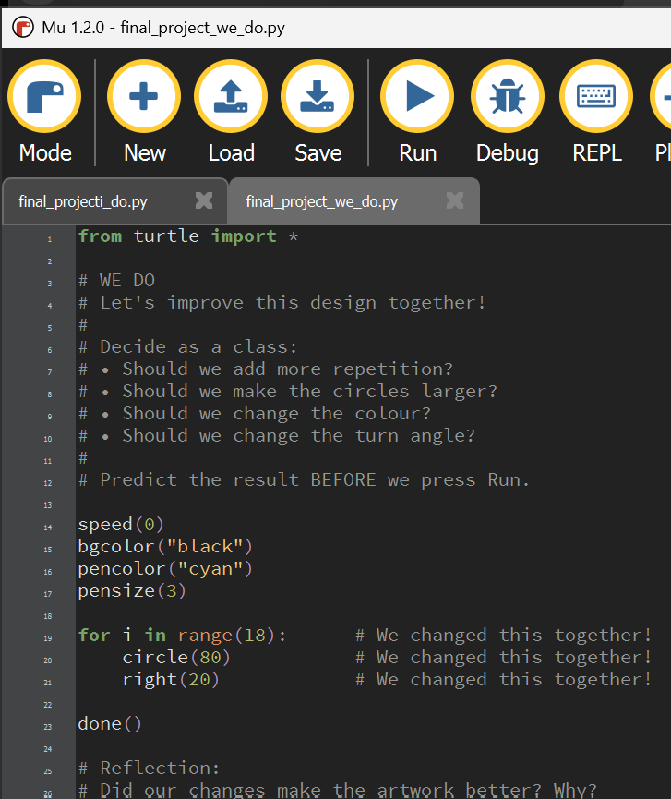
WE DO
Study the final project example below. Predict what students will need to change before starting.
We Do: choose a pathway and plan one first change together.
Download We Do .py file
Code Kaleidoscope • Creative Code. Colourful Thinking.
7

Slide 8
YOU DO
Independent Task
Create an original design using Bronze, Silver or Gold support.
Teacher prompt: pause, predict, test, then explain.
Code Kaleidoscope • Creative Code. Colourful Thinking.
8

Slide 9
WORKBOOK
Record Your Thinking
Complete the design questions, development log and evaluation.
Teacher prompt: pause, predict, test, then explain.
Code Kaleidoscope • Creative Code. Colourful Thinking.
9

Slide 10
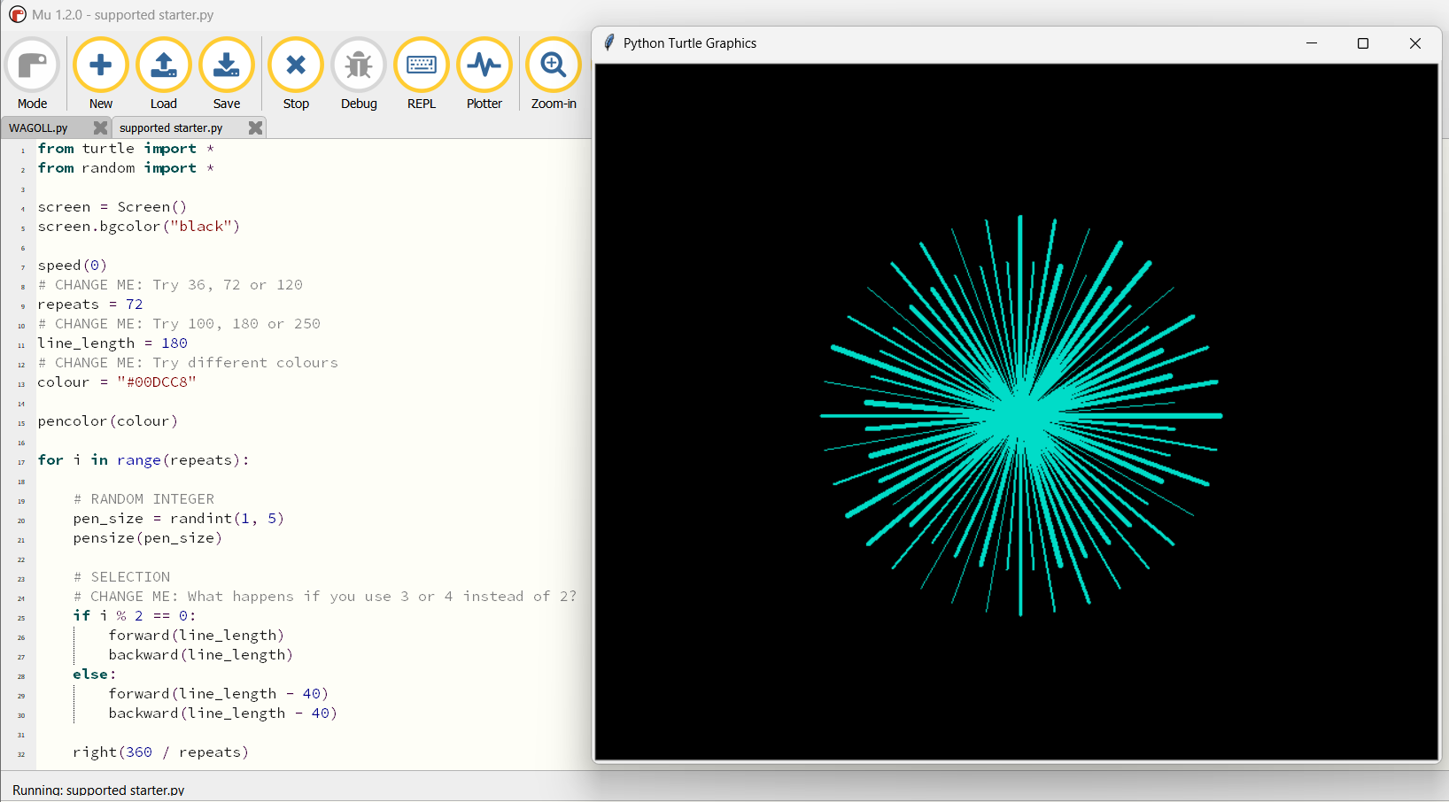
WAGOLL
What a Good One Looks Like
Use this example to discuss what works well and what could be modified.
Code Kaleidoscope • Creative Code. Colourful Thinking.
10

Slide 11
SUCCESS CRITERIA
By the End of the Lesson
✓ I can plan a creative coding outcome.
✓ I can combine concepts from the unit.
✓ I can test, refine and evaluate my project.
Code Kaleidoscope • Creative Code. Colourful Thinking.
11

Slide 12
PLENARY
Plenary Question
What is the strongest part of your final design, and why?
Answer in your workbook using key vocabulary from today.
Code Kaleidoscope • Creative Code. Colourful Thinking.
12

